Slide 1
Advanced SQL

Slide 2
Why
Quick Analysis
Large Datasets need optimization
Covering Edge Cases
Analytics job

Slide 3
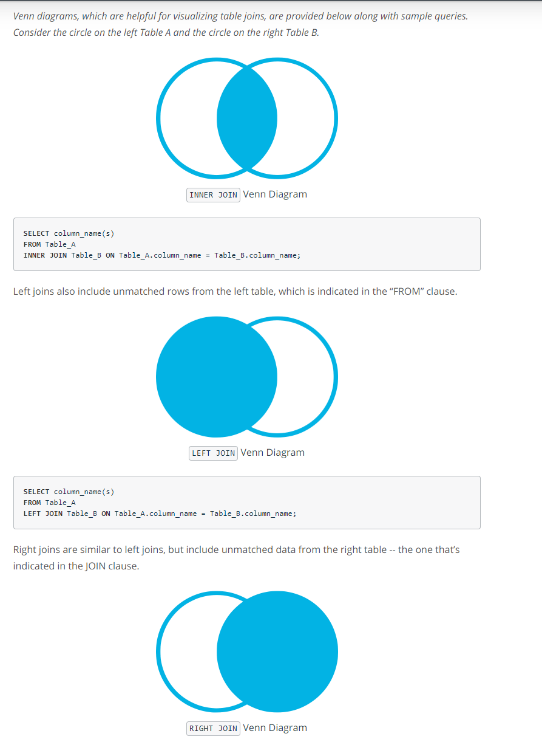
Revisiting Joins

Slide 4
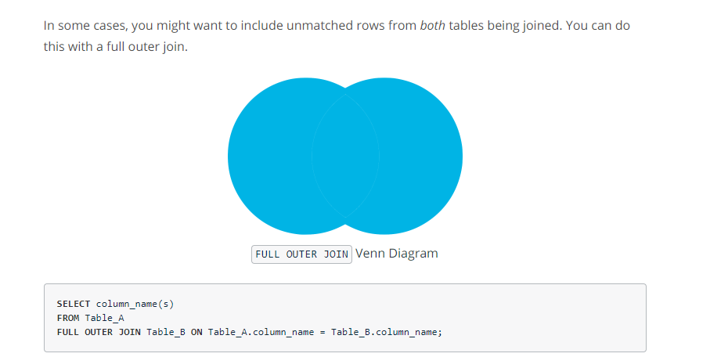
Full Outer Join
Sometimes we also need to include unmatched rows.
A full outer join returns unmatched records in each table with null values for the columns that came from the opposite table.

Slide 5
Full Outer Join Application Example
A common application of this is when joining two tables on a timestamp.
Lets say we have a scenario where there are 2 tables.
Table 1 contains the number of item1 sold each day.
Another table contains the number of item 2 sold each day.
Now, if a date exists in one table but not in the other table than it will not be included with an inner, left or right join.
The only way to make sure that both dates make into the result table is full outer join.

Slide 6
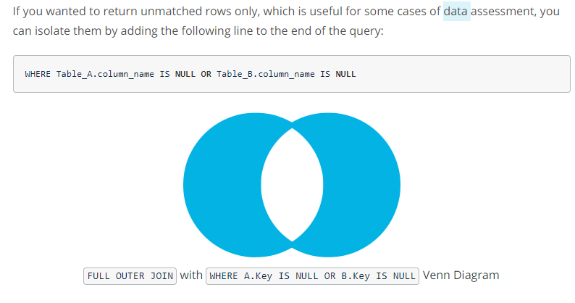
Using Full outer join to return unmatched rows
Useful in some cases.
We can isolate these cases by filtering out the results where either table column is null.
So, what happens is that in case of full outer join the cases where there is no match they come into result but the columns on which we are joining are assigned null values. So using this fact we can use only those rows where we have nulls.

Slide 7
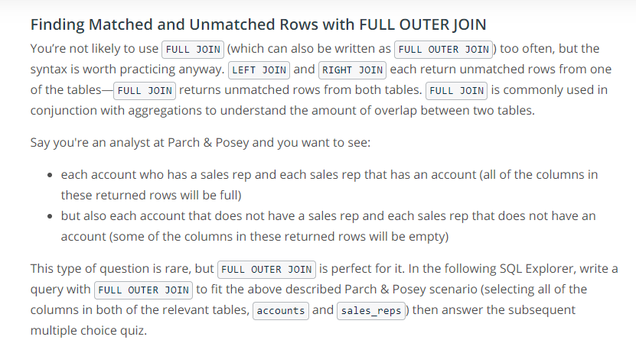
Quiz

Slide 8
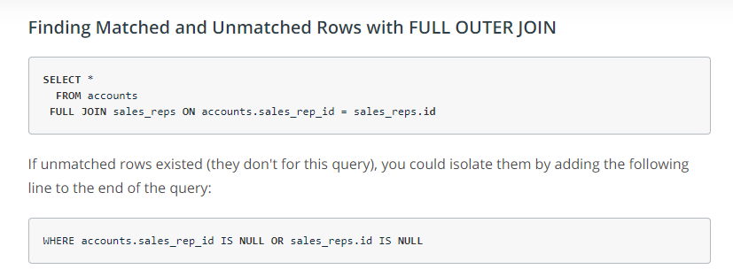
Solution

Slide 9
When is a good situation to use a full outer join ?
Exception reports
ETL
Data Analysis
When we have data on both sides that we are trying to combine.
Alternative is to use a inner join in query & than a right join in an another query & than use union clause to combine the results. The benfit of this alternative method is that we can customize each separate join
Notes:
https://stackoverflow.com/questions/2094793/when-is-a-good-situation-to-use-a-full-outer-join

Slide 10
Joining without an Equals Sign
There are cases when we don’t want to join using equality.
Imagine a marketing scenario, in order to determine how effective campaigns are we want to look at all the actions that a customer took, prior to making their first purchase.
We want to look at all the web traffic events before the accounts first order.

Slide 11
Example – Non Equal Join
Start with the query to return all the first order, selecting the order of the minimum time.
We did this using order table.
Than we join the web events table using an inequality join.
We would like to see the web events for the dates which were before the day that account made an order.
We use conditional statements in the join clause.

Slide 12
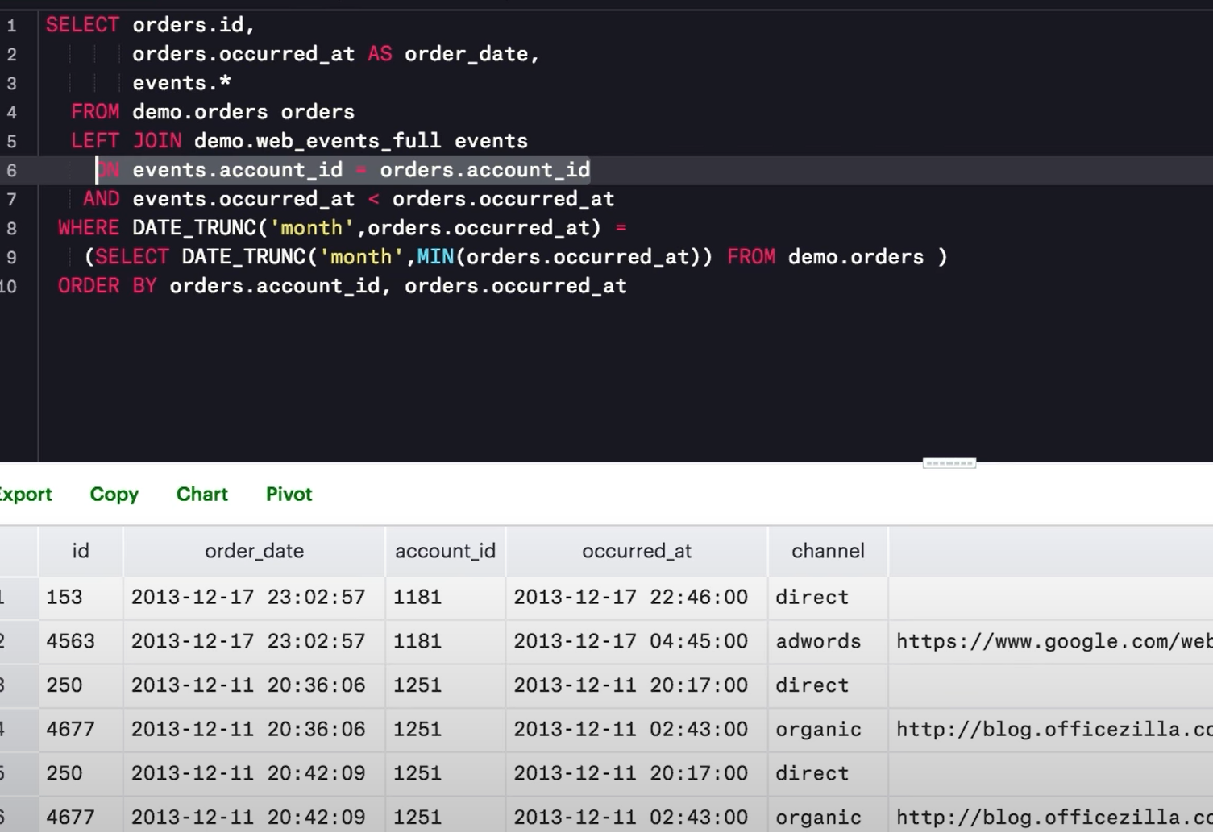
Example Continued
The first join is made on the orders & accounts id.
The 2nd join condition gets us the rows which are less than when order occurred for that id. It is an additional filter.
It’s a little difficult to predict the results when we are joining using in-equalities.
The results may not give the hints whether we have the right results or not.
Notes:
If you recall from earlier lessons on joins, the join clause is evaluated before the where clause -- filtering in the join clause will eliminate rows before they are joined, while filtering in the WHERE clause will leave those rows in and produce some nulls.

Slide 13
Inequality Operators in join
They don’t have to be numbers or dates only
They can be strings as well.

Slide 14
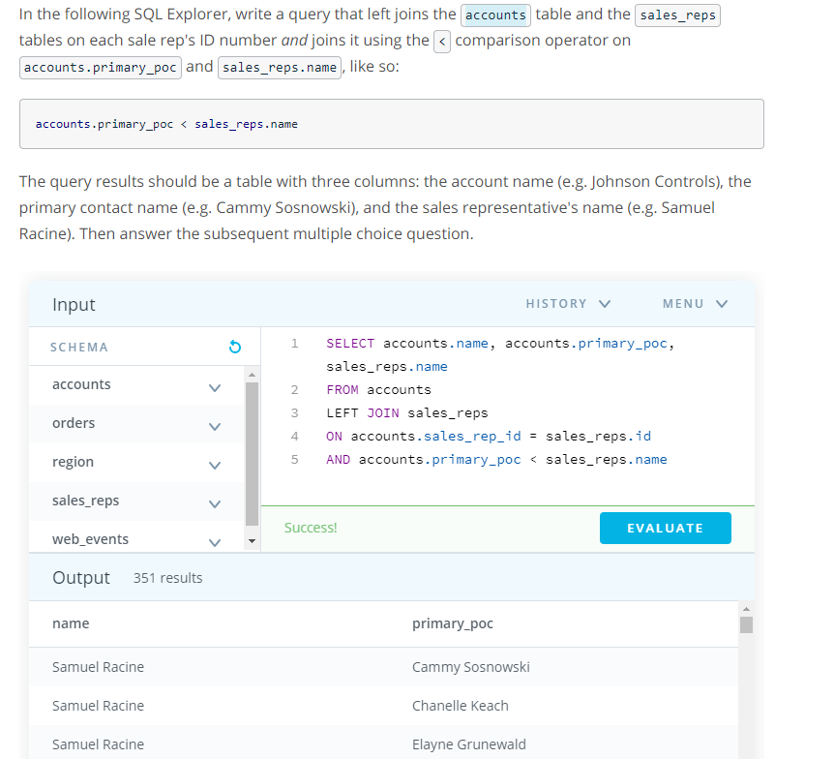
Example
Notes:
In this example, we are including the results where primary_poc comes before the name of sales_rep

Slide 15
Comparison Operators
< , > they work with numbers as well as strings.
String comparisons are usually case-insensitive
Notes:
A: Yes, because 'b' comes before 'w' in the characteset collation, the expression
'ball' < 'water’
https://stackoverflow.com/questions/26080187/sql-string-comparison-greater-than-and-less-than-operators/26080240#26080240

Slide 16
Self Join
Sometimes useful.
Optimal to show parent – child relationship type scenarios.
In order to find cases when two events both occur one after the other.
Often comes up in interviews.
For example, we may want to know which accounts made multiple orders within 30 days.
One way would be to join the table with itself with an inequality join.

Slide 17
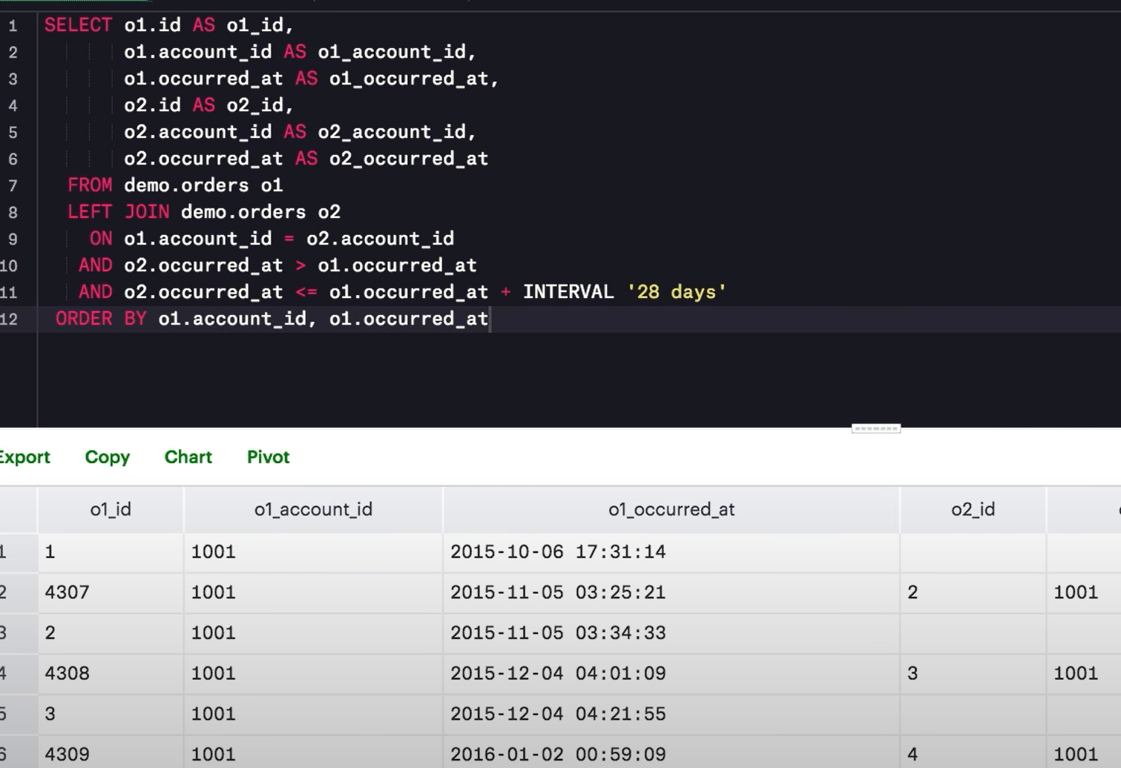
Self Join Example
Doing join on the same table with itself.
We want the records in o2 to be within 28 days after the records in o1.
We are usuing conditional statements for this.
The first condition is to find the orders after that order 1 date & than we need to time bound for 28 days.
Aliases are very important iin self joins.

Slide 18
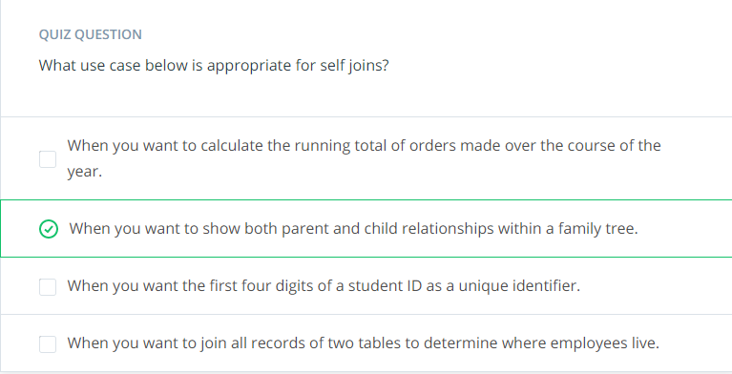
Quiz - 1

Slide 19
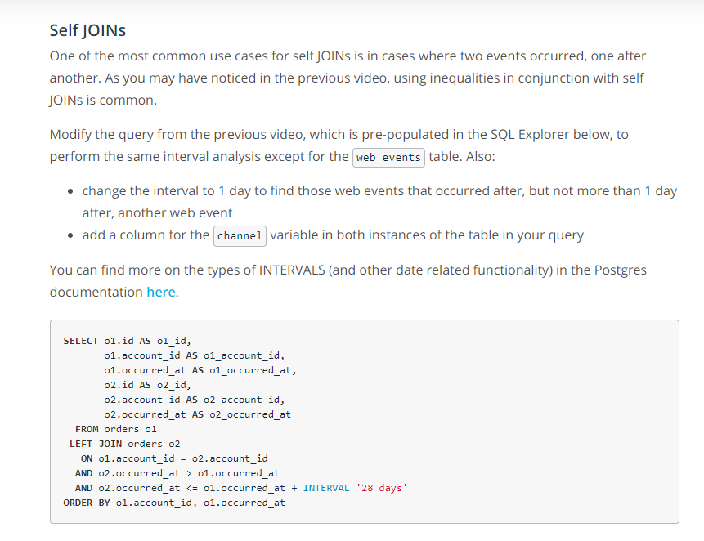
Quiz 2
Notes:
https://www.postgresql.org/docs/8.2/functions-datetime.html

Slide 20
Appending Data via UNION
Used to combine the results of 2 or more select statements.
Joins allow us to join tables side by side.
Sometimes it is required to combine tables by stacking them.
It removes the duplicate rows between various select statements.
Mostly the data is same at different places.

Slide 21
Requirements for Union – Same number & Data type
Each SELECT statement within the UNION must have the same number of fields/columsn in the result sets with similar data types.
The corresponding expressions must have the same data type in the SELECT statements. For example: expression1 must be the same data type in both the first and second SELECT statement.

Slide 22
Misconception
Column names don’t have to be the same,
Column names, in fact, don't need to be the same to append two tables but you will find that they typically are.

Slide 23
Use Case Example
Typically, the use case for leveraging the UNION command in SQL is when a user wants to pull together distinct values of specified columns that are spread across multiple tables.
For example, a chef wants to pull together the ingredients and respective aisle across three separate meals that are maintained in different tables.
Sometimes the email addresses, lists of events may be stored in few different places & we would like to get a combined list.
Sometimes we may want to append an aggregation on the end of individual records.

Slide 24
Union Vs Union ALL
Distinct . Union removes the duplicates.
Not distinct , Union All does not remove duplicates.
Union all is usually more frequently used.

Slide 25
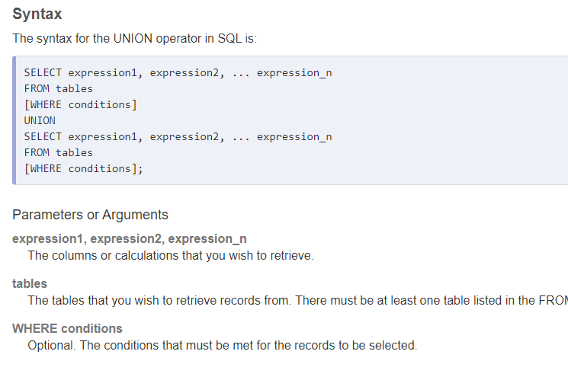
Syntax

Slide 26
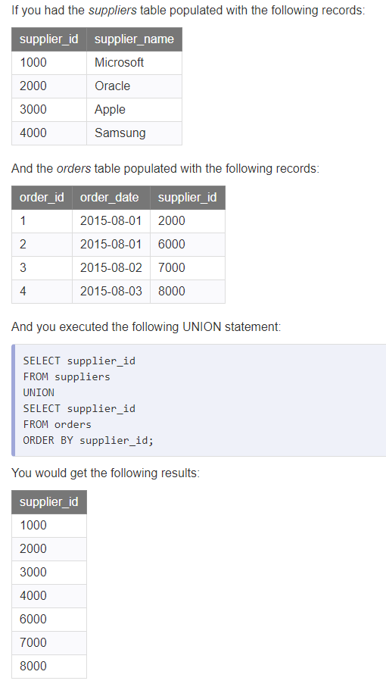

Slide 27
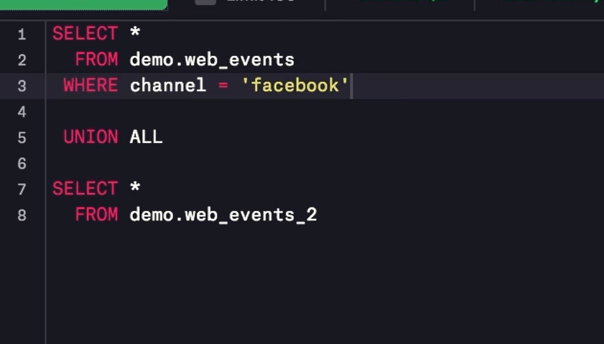
Union Benefit – Pretreating
Using union we can treat the queries separately & use it for filtering & all.

Slide 28
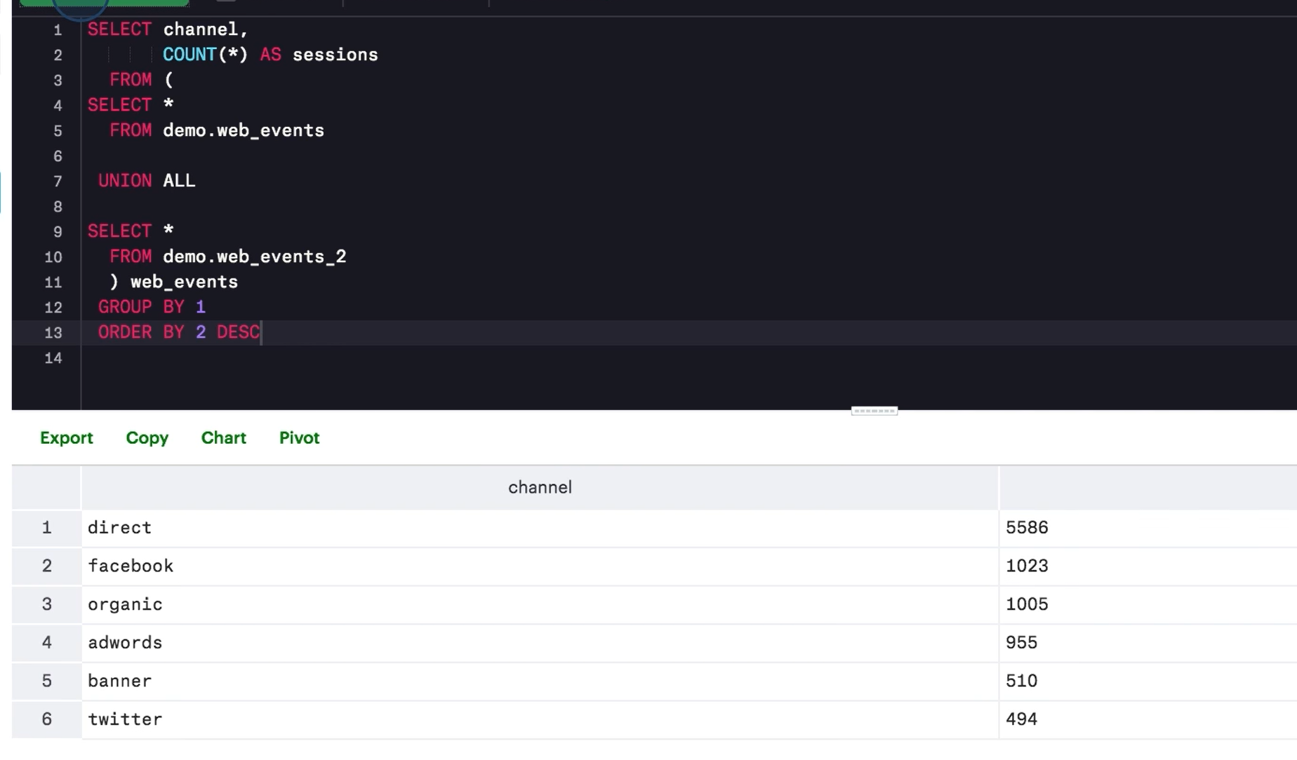
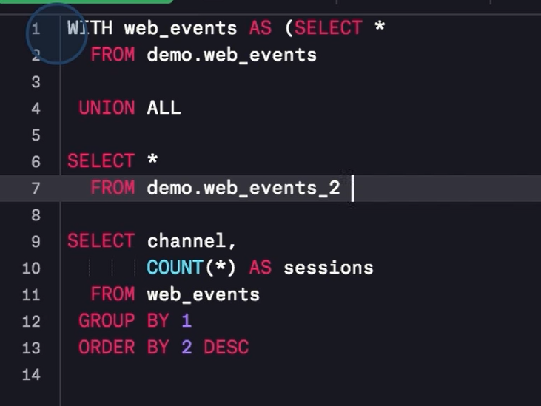
Combined Operations on Entire Unionized Dataset
Convert the union results into a subquery to perform calculations on top of it.
Though a cleaner way would be to perform union as CTE & use the results further to compute results.

Slide 29
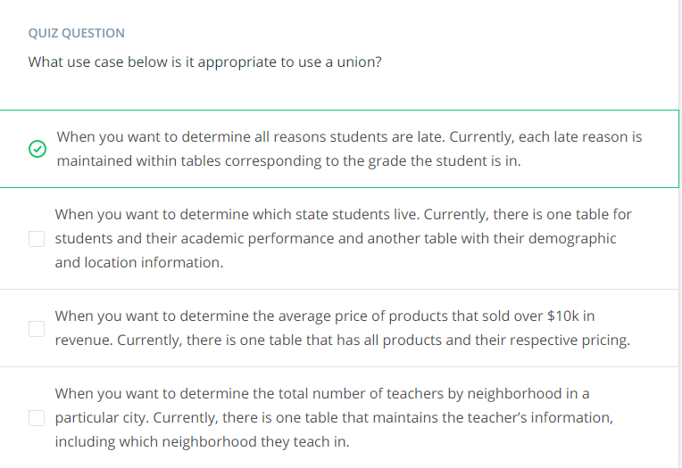
Use Case Quiz

Slide 30
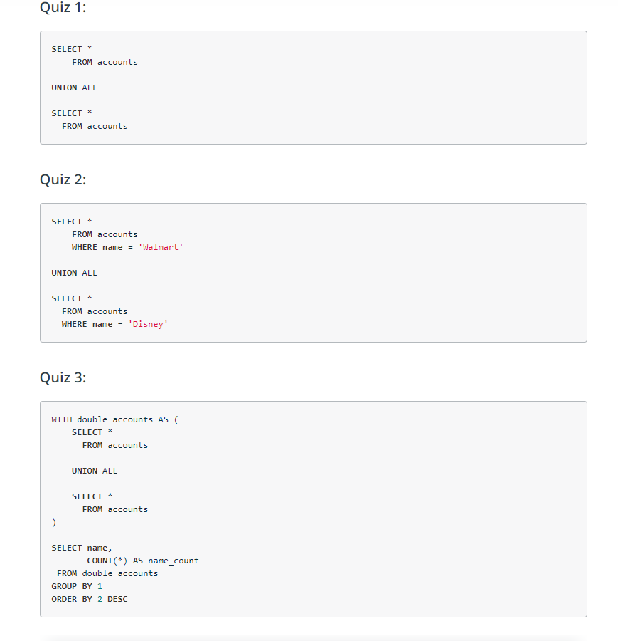
Quiz

Slide 31
Performance Tuning
SQL queries sometimes need to be tuned.
Speed is sometimes key.

Slide 32
How You Can and Can't Control Performance
Database is a software, dependent upon hardware.
To make it run faster, we need to decrease the calculations.
For this, we need to understand how they work.

Slide 33
Factors affecting number of calculations in a query
Table Size – if more than 1 tables with a lot of rows than it gets slower.
Joins – If we are joining tables which increases the row count than it can cause slowness of the queries.
Aggregations – Combining multiple rows require more calculations as compared to regular retrieval. For example, count distinct will be much slower as compared to count since it will have to check each row against every other row.

Slide 34
Database factors
Number of queries running at a time.
Different database have different optimizations.
For example, postgres is optimized to read & write new rows quickly where as redshift is optimized for faster aggregation.
These things, if we know can help us to write efficient queries. However, these kind of optimizations are not really in our controls.

Slide 35
Factors -- we can control
Filtering will always increase the speed.
For example, timeseries data can be filtered for a small time window.
We can always refine our query on a small subset & than later on apply the final query on full dataset.
In case of aggregations, limits don’t really will help.
Aggregations are performed first & than the results set is limited.
In such a case, we can limit the data using a subquery & than perform aggregation on the limited data.
To test query logic, apply limits inside the sub query.

Slide 36
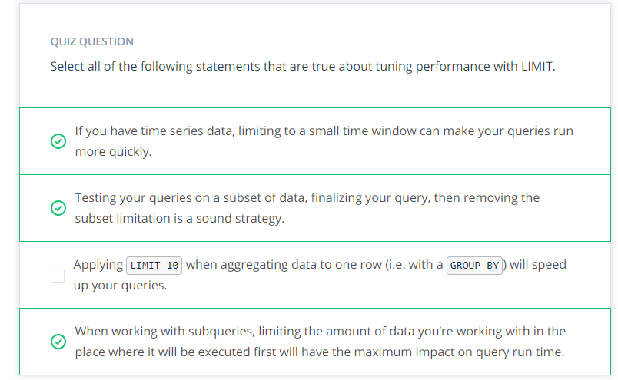
Limit Quiz

Slide 37
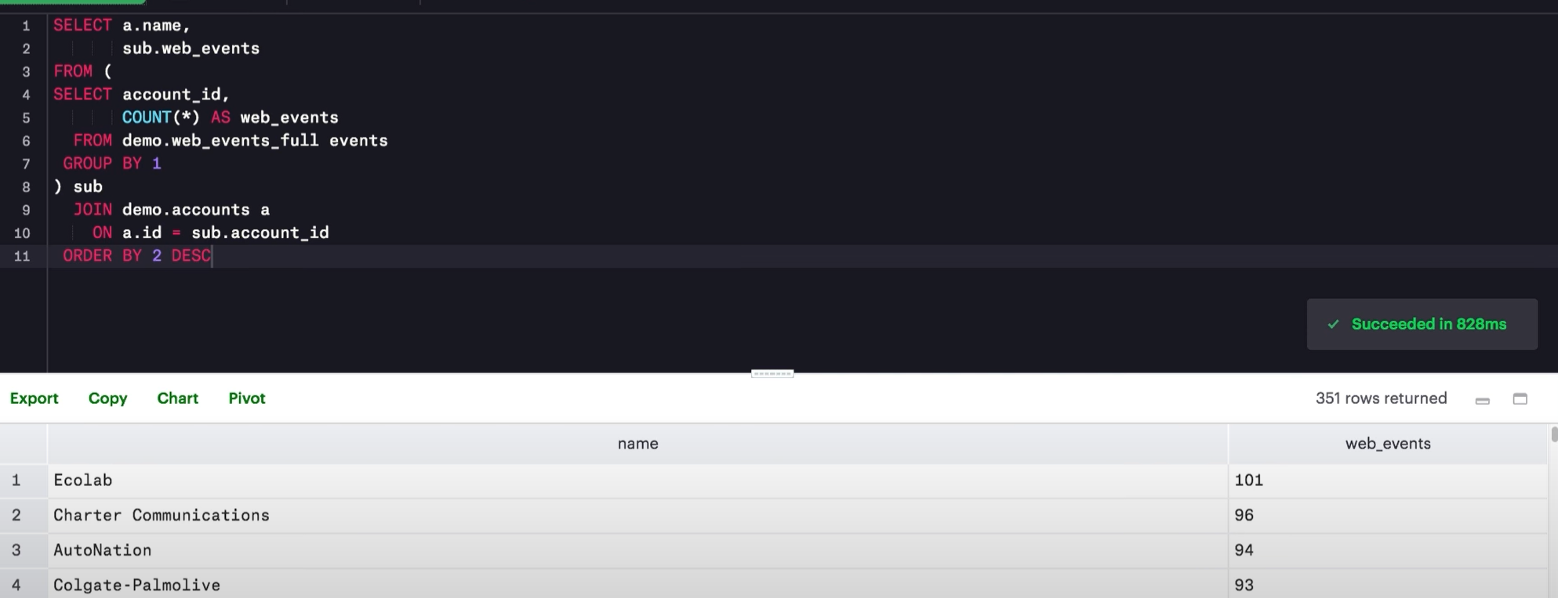
Making Joins Less Complicated
Reduce the number records of joins if logic allows.
Aggregate before joining.
Apply filters before the join so that the rows which are being evaluated decreases.
Sub queries can be used efficiently for this purpose.

Slide 38
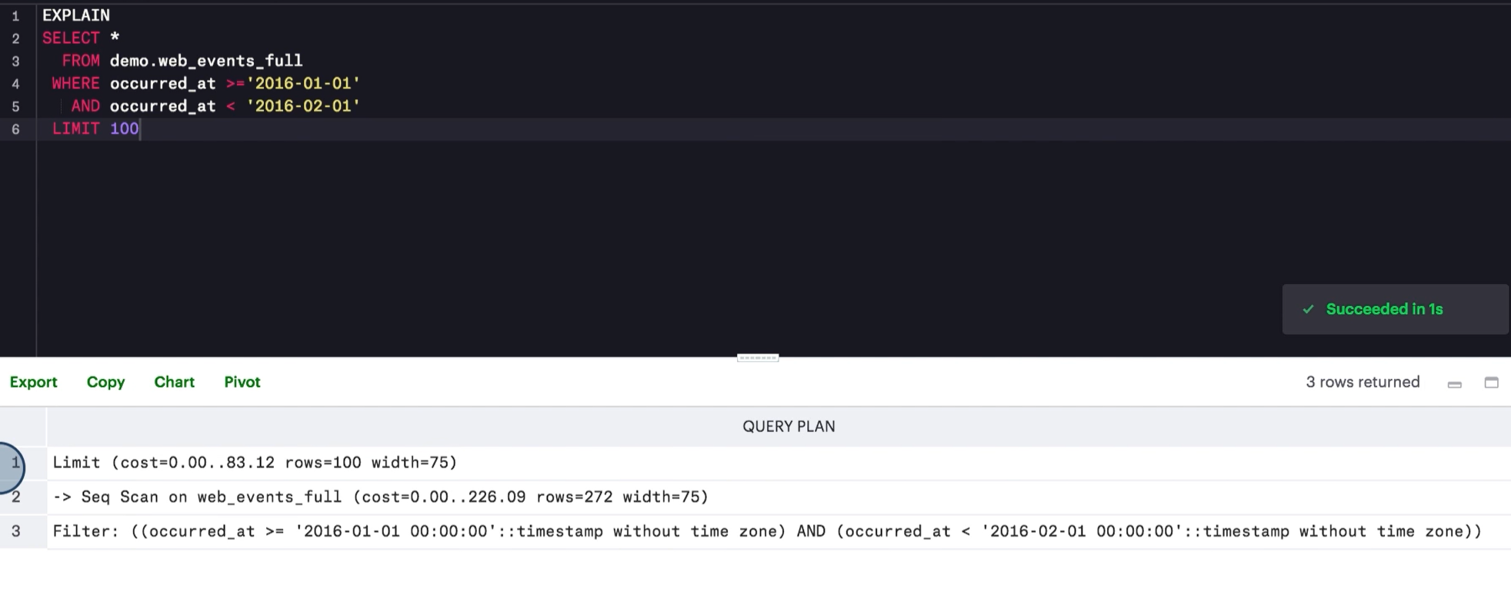
Explain
How long query will take.
Approximate cost.
Query plan to get a sense of the query time & modify the steps which are expensive.

Slide 39
Joining Sub-Queries to Improve Performance
Sub qrs are specially helpful in improving the performance.
Sometimes, we can compute the results in our big query but there is advantage in computing intermediate results in sub queries & than joining them.

Slide 40
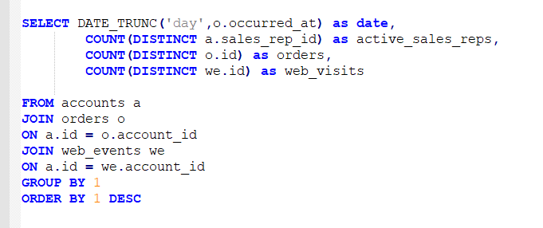
Optimization Query Example

Slide 41
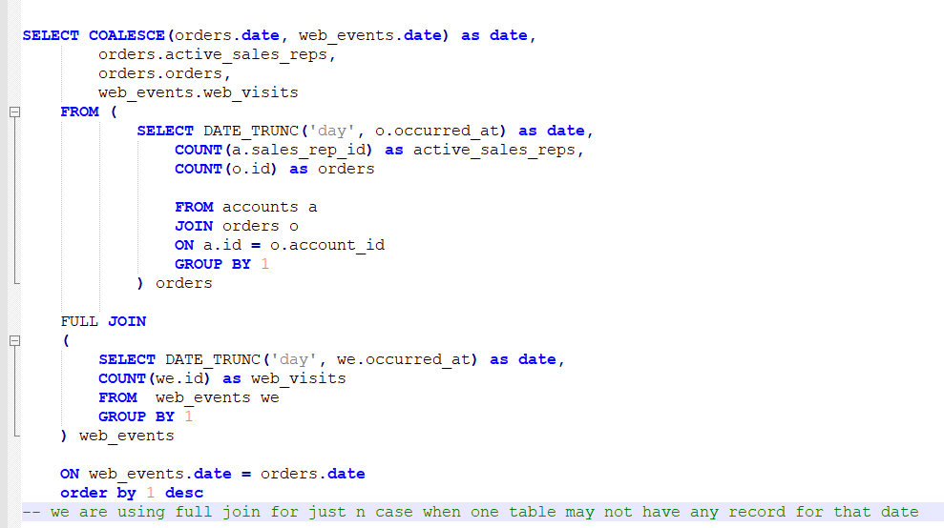
Optimized Version
Notes:
Detail is in the notepad file

